Slide 1
ENCOUNTERS WITH JESUS
Stories of Jesus’ interaction with people in John and what that means for us now

Slide 2
ENCOUNTERING JESUS IN GRIEF
Jesus with a grieving family JOHN 11:1-57

Slide 3
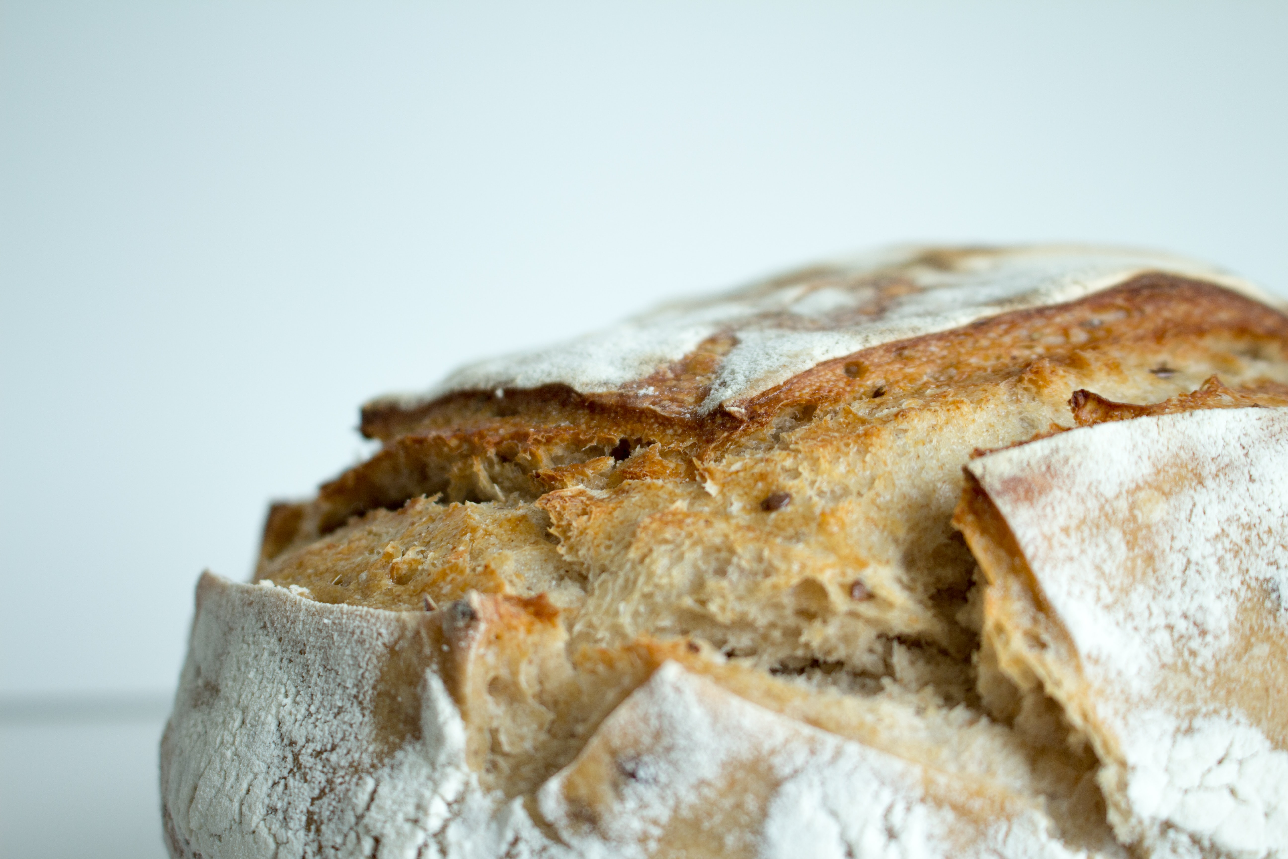
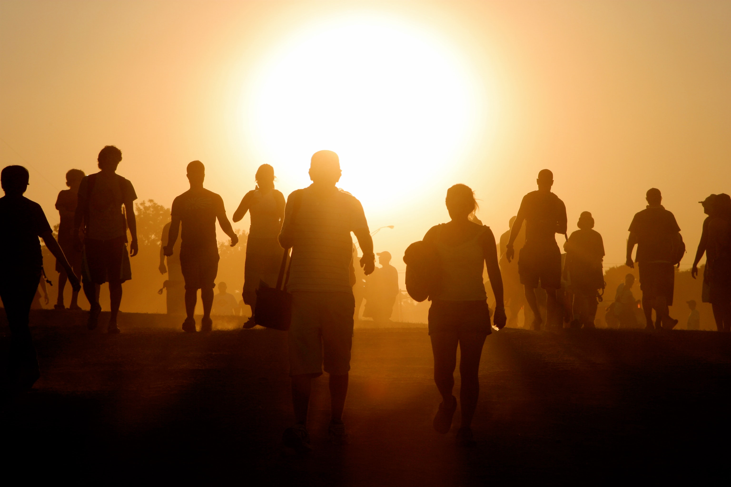
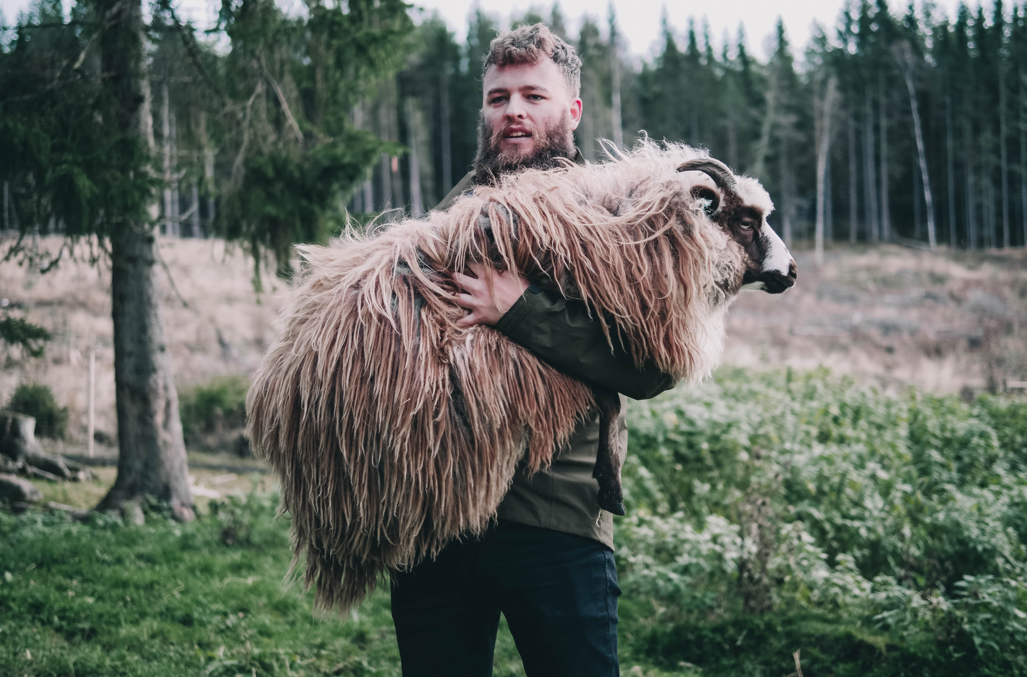
ENCOUNTERING JESUS IN GRIEF: THE CONTEXT
8:12
& 9:5
6:35
7
‘I AM’
statements of
Jesus
in John
10:7
15:1-5
10:11-14
14:6
JOHN 11:1-57
11:25

Slide 4
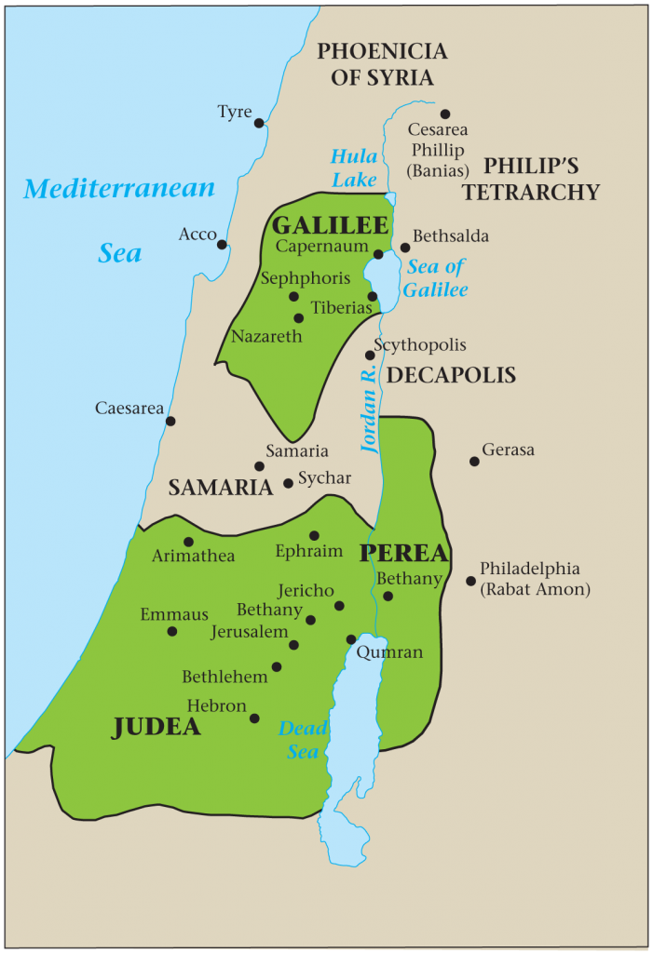
ENCOUNTERING JESUS IN GRIEF: THE STORY
Mary and Martha messaged Jesus about Lazarus’ illness
JOHN 1:40-42; LUKE 13-16: JOHN 11:1-6

Slide 5
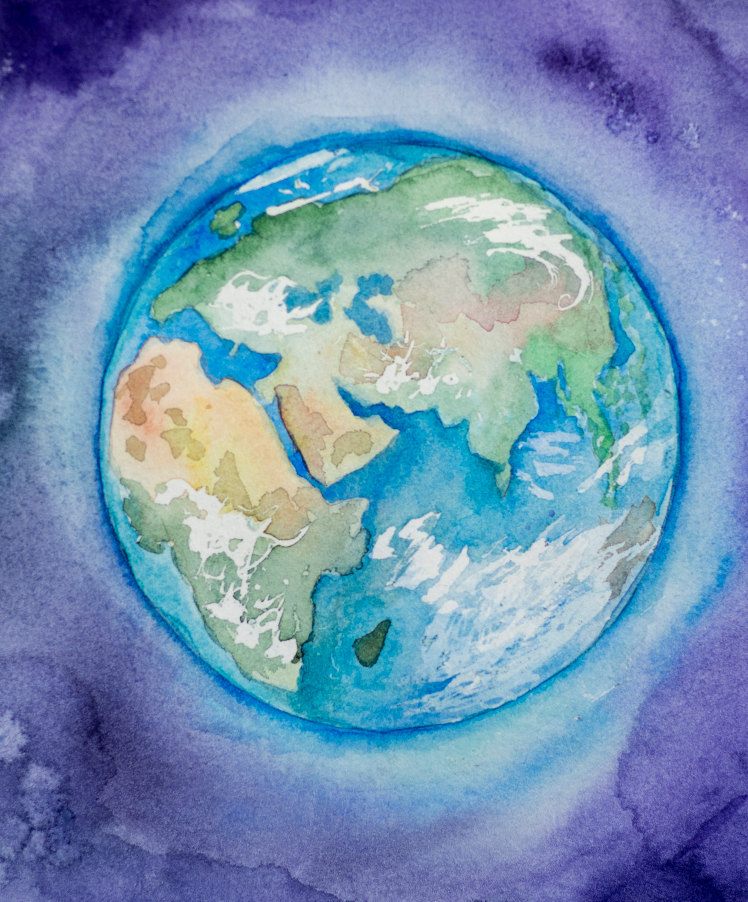
ENCOUNTERING JESUS IN GRIEF: THE STORY
The end would not be Lazarus’ death, but Jesus’ glorification
BIG PICTURE OVERVIEW
JOHN 11:4-6

Slide 6
ENCOUNTERING JESUS IN GRIEF: THE STORY
Jesus’ plan to return
worried the disciples
JOHN 11:7-8 & 16

Slide 7
ENCOUNTERING JESUS IN GRIEF: THE STORY
Jesus’ 2-part answer
1. It’s daytime and I must work
2. Lazarus is dead and I will raise him
JOHN 11:9-15

Slide 8
ENCOUNTERING JESUS IN GRIEF: THE STORY
CONVERSATION WITH MARTHA:
“Lord,” Martha said to Jesus, “if you had been here, my brother would not have died. But I know that even now God will give you whatever you ask.”
Jesus said to her, “Your brother will rise again.”
Martha answered, “I know he will rise again in the resurrection at the last day.”
JOHN 11:21-27

Slide 9
ENCOUNTERING JESUS IN GRIEF: THE STORY
Jesus said to her, “I am the resurrection and the life. The one who believes in me will live, even though they die; and whoever lives by believing in me will never die. Do you believe this?”
“Yes, Lord,” she replied, “I believe that you are the Messiah, the Son of God, who is to come into the world.”
JOHN 11:21-27

Slide 10
ENCOUNTERING JESUS IN GRIEF: THE STORY
GRIEVING WITH MARY & OTHERS
“Lord, if you had been here, my brother would not have died.”
When Jesus saw her weeping, and the Jews who had come along with her also weeping, he was deeply moved in spirit and troubled.
“Where have you laid him?” he asked.
“Come and see, Lord,” they replied.
Jesus wept.
JOHN 11:28-37

Slide 11
ENCOUNTERING JESUS IN GRIEF: THE STORY
GRIEVING WITH MARY & OTHERS:
Then the Jews said, “See how he loved him!”
But some of them said, “Could not he who opened the eyes of the blind man have kept this man from dying?”
JOHN 11:28-37

Slide 12
ENCOUNTERING JESUS IN GRIEF: THE STORY
LAZARUS RAISED DESPITE REASONABLE OBJECTIONS
Take away the stone.
But, Lord, by this time there is a bad odour, for he has been there four days.
Did I not tell you that if you believe, you will see the glory of God?
So they took away the stone.
JOHN 11:38-44

Slide 13
ENCOUNTERING JESUS IN GRIEF: THE STORY
Then Jesus looked up and said, “Father, I thank you that you have heard me. I knew that you always hear me, but I said this for the benefit of the people standing here, that they may believe that you sent me.”
When he had said this, Jesus called in a loud voice, “Lazarus, come out!”
The dead man came out, his hands and feet wrapped with strips of linen, and a cloth around his face.
Jesus said to them, “Take off the grave clothes and let him go.”
JOHN 11:38-44

Slide 14
ENCOUNTERING JESUS IN GRIEF: THE STORY
1. The religious leaders plot to kill Jesus [JOHN 11:38-44 ]
2. Lazarus at the dinner in honour of Jesus [JOHN 12:1-8]
3. The religious leaders plot to kill Lazarus [JOHN 12:9-11]

Slide 15
ENCOUNTERING JESUS IN GRIEF: SIGNIFICANCE
Grief and Loss are a painful part of our human reality
[1 PETER 1:6 & JOHN 16:33]

Slide 16
ENCOUNTERING JESUS IN GRIEF: SIGNIFICANCE
We naturally want to prevent Grief and Loss
[JOHN 11:3]

Slide 17
ENCOUNTERING JESUS IN GRIEF: SIGNIFICANCE
Laying blame is part of what we go through in the grieving process
[JOHN 11:21, 32 & 37]

Slide 18
ENCOUNTERING JESUS IN GRIEF: SIGNIFICANCE
Jesus is greater than life and death which holds no power over those who believe
[JOHN 11:25 & 38-44]

Slide 19
ENCOUNTERING JESUS IN GRIEF: SIGNIFICANCE
Even though we live with hope in Jesus, we still need human comforters
[JOHN 11:19 & 33-36]

Slide 20
ENCOUNTERING JESUS IN GRIEF: SIGNIFICANCE
Just as Jesus was present with them in their grief he wants to be present with us too.
[JOHN 11:33; 1 PETER 5:7]

Slide 21
ENCOUNTERING JESUS IN GRIEF
Jesus with a grieving family JOHN 11:1-57

Slide 22
MESSAGE TITLE GOES HERE
CONTENT GOES HERE
JOHN xxxx

